Slide 1
Natural Language Processing

Slide 2
Natural Language Processing
Tasks: Classification, document retrieval, summarization, question answering, chatbot, translation.
Knowledge based approach vs. Machine learning approach
I will be using English for examples with very rare exceptions. Most of what I say applies to other languages as well, though one should certainly not take that for granted.

Slide 3
Knowledge based approach
We will focus on interpretation: Going from a text* in natural language to an internal symbolic representation of the meaning.
This draws extensively on linguistic theory, though with substantially different emphasis. (Linguists are interested in all kinds of issues that are unimportant for AI; AI has a deep interest in some issues that linguists tend to sweep under the rug.)
* “text” will mean “text or utterance” throughout this course.

Slide 4
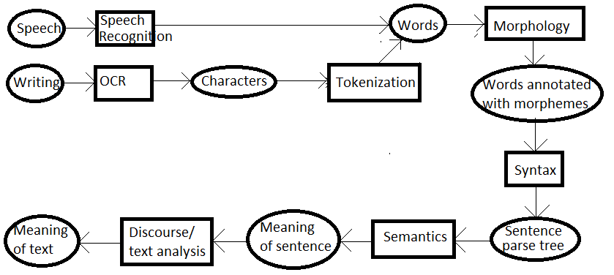
Knowledge based NLP flowchart

Slide 5
Character coding systems
Nightmarish. I don’t even want to get started.
Shows up for the end user when you try cutting and pasting text with strange accents, ligatures, etc.

Slide 6
Tokenization
Breaking a stream of characters into tokens.
Rule that works 98% of the time: Break at white space and punctuation.
Other 2% is misery, particularly since the rise of computerese.
Linguists mostly consider the whole issue not worth thinking about.
Apostrophes. “Mr. O’Neil thinks the boys’ stories about Chile’s capital aren’t amusing.
O’Neill → o ; neill / oneill / o’neill / o’ ; neill
aren’t → aren ; t / aren’ ; t / aren’t / aren’t / are ; n’t

Slide 7
Tokenization
Compounds and Hyphens
Compound names: Los Angeles. San Francisco
Yann Le Cun got so tired of being cited as Cun, Y.L. that he now spells his name Yann LeCun.
Compound nouns: dry cleaning / dry-cleaning / drycleaning
Names with numbers: B-52 bomber. Windows 10.
Hyphens used instead of dashes.
Abbreviations: U.S.A. = USA

Slide 8
Tokenization
Special forms:
Numbers: 17.25 173,652 Money: $17.25. Times: 6:30. Phone numbers. Email addresses. URLs. Non-standard symbols (Emojis, musical notes, mathematical and scientific notations.)
Case normalization: US vs. us
Random punctuation as part of names (very popular in computer stuff). C++. C#. Yahoo!
Should the tokenizer preserve punctuation? Case? Font? Layout?
(Similarly, should voice recognition preserve phrasing, intonation? If so, how?)
Alternatively you can give the later stages access to the original input.

Slide 9
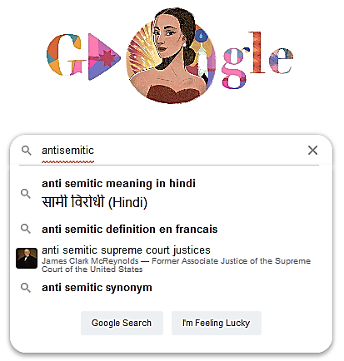
Example to show that even the most sophisticated programs still struggle with tokenization.
Screenshot from a query of mine, last week:
I’ll have another example later in the semester.

Slide 10
Morphology (English)
Two kinds: Inflections and affixes (prefixes and suffixes).
English is a lightly inflected language.
Nouns have singular and plurals. Cat, cats. Fish, fishes. Plus irregular forms.
Verbs have –ed and –ing. Fish, fished, fishing. Plus semi-regular rules for changing letters (cry, cried) plus irregular pasts.

Slide 11
Affixes
Superconductivity =
super (intensifier) + conduct (verb root) + ive (verb to adjective) +ity (adjective to noun)
(conduct itself was a compound − con (with) + ducere (lead) in the original Latin)
civilizationally =
civil (adjective) + ize (adjective to verb) + ation (verb to noun) + al (noun to adjective) + ly (adjective to adverb).

Slide 12
Morphological analysis: Lemmatizers vs. stemmers
Lemmatizers: Do it correctly. Generally need a dictionary. The root is a word.
Stemmers: Strip off affixes, prefixes, inflections. The root is not necessarily a word. E.g. The Porter algorithm (widely used) reduces argue, argued, argues, arguing, all to “argu”. One has to be careful; e.g. one does not want to reduce “crisis” to “crisi” + “s”

Slide 13
Highly inflected languages
Latin:
Each noun has singular and plural and five cases depending on its use in the sentence (nominative, genitive, accusative, dative, ablative, vocative). There are five different systems for doing this (declensions) plus irregulars. (This does a lot of what in English is done with word order.)
Each verb can be singular or plural, any of three persons, three tenses, two voices (active or passive) and three moods (indicative, subjunctive, imperative). It’s not quite the cross-product of 108 forms, but it’s a good fraction of them. There are four different systems for doing this (conjugations) plus exceptions.
Arabic and Hebrew are worse as regards verbs, though simpler as regards nouns.

Slide 14
Agglutinative languages
German
Lebensversicherungsgesellschaft = Life insurance company
Lebens – life: leben+s
Versicherungs – insurance ver+sich+er+ung+s
Gesellschaft = company.

Slide 15
Syntax
What sequences of words are valid sentences?
What is the internal structure of a sentence? (Needed for semantic analysis)
There are multiple theories of syntax.
There are syntactic theories that account for all, or most, of the grammatical structure of English.
Caveat: The boundary between syntactic and semantic features of a language is not well defined, and different syntactic theories have different coverage.
Caveat: The Cambridge Grammar of the English Language is 1842 pages long.
I will focus on phrase structure grammar.

Slide 16
Parts of speech
Open categories: Each category has many words. New words are easily added.
Nouns, verbs, adjectives, adverbs.
Closed categories: Each category has comparatively few words. The category is quite stable over historical time.
Pronouns, prepositions, conjunctions, determiners.
Generally there are more categories than these, and in specific applications there may be much finer categories.
There can be categories with only a single word. E.g. in English, the only way to form an infinitive (“to go”, “to write”…) is with “to”. This is a grammatical function for which there is only one choice.

Slide 17
Phrase categories
Noun phrase (NP): “Biden”, “happy children”, “the five happy children I saw in the park”
Verb phrase (VP): “swim”, “caught five fish”.
Prepositional phrase (PP): “in the park”
Sentence (S): “I saw five happy children in the park”.
These are also closed categories.
These are also called “non-terminals” for reasons that will soon be clear.

Slide 18
Phrase structure tree
A tree where:
The leaves are labelled with the words of a sentence, left to right.
The second level labelled with are the associated parts of speech.
The higher-level nodes are labelled with phrase categories.
The root is labelled S.

Slide 19
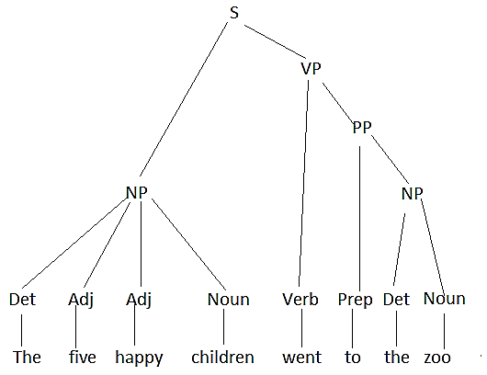
Example

Slide 20
Phrase structure grammar
Specifies what phrase structure trees are possible.
Lexicon: Lists the possible parts of speech for a word. Relation between bottom and next level of the tree.
Grammar: Specifies the possible structures for the inside of the tree.
Usually formulated as a context-free grammar (CFG).
Rules that specify, given a non-terminal at a node, what are its possible children left to right.
Common view the grammar of natural languages centers around a context-free grammar (CFG plus some non-context-free features or operations). Same is true of programming languages.

Slide 21
Forms of rules
Non-terminal → sequence of non-terminals plus parts of speech.
Example.
S → NP VP
PP → Prep NP
NP → Pron
Even more restricted: The right side always has exactly two symbols on the right (Chomsky Normal Form)

Slide 22
Other common notations in CFG rules
| : Or
* : Any number, including zero (Kleene (pronounced ‘Kleeney’ star)
{} : Optional
+ : At least one
NP → Pron | Name | { Det } Adj* Noun PP*
A noun phrase may be either a pronoun, or a name, or a phrase consisting of an optional determiner, followed by any number of adjectives, followed by a noun, followed by any number of prepositional phrases.

Slide 23
Simple grammar
S → NP VP
NP → Pron | Name | { Det } Adj* Noun PP*
VP → {Modal} Verb {NP} PP*
PP → Prep NP

Slide 24
Equivalence
Any grammar that can be expressed using the richer notation can also be expressed in Chomsky Normal Form, at the cost of introducing additional phrase categories and more rules.
Advantages of the more expressive notations: More compact. More natural phrase categories and phrase tree. Fewer arbitrary choices.
Advantage of the more restricted notation: Easier to write algorithms to convert the rules into a parsing algorithm.

Slide 25
What features to include in the CFG?
For instance: Subject/verb number agreement. You can do this, at least to some extent, in a CFG:
S → SingNP SingVP | PluralNP PluralVP
or
You can state this as a grammatical constraint outside the CFG
or
You can punt and decide that this is a semantic constraint, not a syntactic one.

Slide 26
Putting it in the CFG
Disadvantages:
You have to continue doubling all the way down the tree until you reach the adjective or noun and the verb that indicates number.
The rules that you’ve doubled are largely the same, except for their number label. You’re missing important generalizations about the language.
If you have k independent features that have to agree, you need to multiply by 2^{k}.
Advantages:
There is a single mechanism, conceptually simple, and easy to implement.

Slide 27
Grammatical constraints outside the CFG
Advantages:
Seems like the right way to do things.
Supports powerful generalization
Disadvantages:
Really hard to come up with a good notation for everything you want to do. Your grammatical notation starts to drift toward a poorly designed programming language. See the section on “Augmented Grammars” in Russell and Norvig.
If you do come up with a good notation, it may be very hard to automate its translation into code.

Slide 28
Calling it a semantic constraint
Disadvantages:
You’re just kicking the problem down the road
Everyone has always considered this grammatical. Constraints on features that are marked by word inflections are considered grammatical.
Advantages.
The semantics is in any case going to have to deal with a lot of these kinds of constraints that no one calls grammatical; e.g. that an animate verb (e.g. “breathe”) requires an animate subject (e.g. “animal”)

Slide 29
Broadly speaking
Linguists prefer theories that are compact but structurally complex.
AI people tend to prefer theories that are structurally simpler but large.
Computers are fine with large.
Structurally complex theories are
Hard to get right.
Hard to combine.
Hard to implement.
Hard to get data.
Hard to learn from data.
Easy to miss unintended consequences until you implement and run.

Slide 30
Parsing
Given a sentence, find the phrase structure tree.
Similar problem in building a compiler, but with two differences:
Programming languages are designed so that they are unambiguous; given a program, there is at most one syntax tree. Natural language has an ambiguous grammar.
The grammar of a programming language is generally carefully designed so that parsing can be done quickly (e.g. the category is indicated by the first symbol). Natural languages do not follow those constraints.

Slide 31
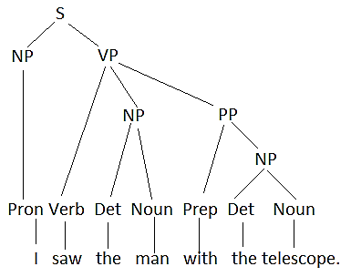
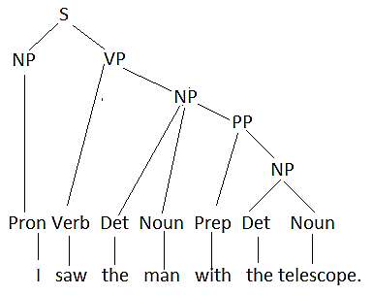
Syntactic ambiguity “I saw the man with the telescope”
Meaning: I used the telescope to see the man
Meaning: I saw the man who had the telescope.

Slide 32
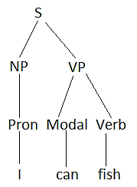
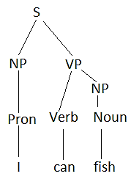
Syntactic ambiguity “I can fish”
Meaning: I am able to fish.
Meaning: I pack fish into cans.

Slide 33
Grammars are mostly generative
Most theories of grammar describe how a process of generating a grammatical sentence.
The problem of parsing is viewed as an inverse problem.

Slide 34
Probabilistic context free grammar (PCFG)
A stochastic generative model for phrase structure trees.
Modify the grammar as follows:
Turn around the lexicon, so those have the form POS → word E.g. Noun → “cat”. Noun →“dog” Noun →“fish”
Assume that all the rules other than the ones in step 1 are in Chomsky normal form: A → B C, with two non-terminals on the right. (One can make this more general but it simplifies the algorithm.)
For each non-terminal W, assign a probability distribution to the rules that have W on the left.

Slide 35
PCFG
Stochastic generative model:
Begin a tree T with node S at the top.
Repeat { N = the leftmost leaf in the tree with a non-terminal label X;
Choose rule R of the form X → Y Z or X → Word according to the probability distribution.
Make nodes labelled Y and Z or labelled Word, and make them children of N;
} until (all the leaves of T are labelled with terminals)

Slide 36
PCFG
The probability of a tree T is just the product of all the probabilities of all the rules X → Y Z where X is the parent of Y, Z in the tree.
Independence assumption: All the choices made in building the tree are independent of one another. Wildly implausible.
Parsing problem: Given a sentence and a PCFG, find the most probable tree whose leaves are the sentence.
CYK algorithm: A dynamic programming algorithm to solve the parsing problem. (Sometimes known as CKY.)

Slide 37
Bottom-up CYK Parser
General idea: we’ll build the tree bottom up, first creating nodes for the parts of speech, then sequences of 2 words, then sequences of 3 words and so on.

Slide 38
Bottom-up CYK Parser
Tree[][][] P;
P[M,I,J] is the root of the most probable tree that has label M and that spans sentence words indexes I to J. The data structure is called a “chart”
class Tree { % Possible node in the parse tree
NonTerm phrase; % The non-terminal label
int StartPhrase, endPhrase; % indexes of the words in the subtree
String word; % if the node is a POS, then this is the word.
Tree left;
Tree right;
double prob; % probability of the subtree
}

Slide 39
function CYK-Parse: initialization
function CYK-PARSE(sentence, grammar) return chart;
% initialize bottom level of tree with words and POS
Tree[][][] P = new Tree[number of POS][N][N];
N = length(sentence);
for (i = 1 to N)
for (each rule “POS word [prob]”)
P[POS,i,i] = new Tree(i,i,POS,word,null,null,prob);

Slide 40
function CYK-Parse: initialization
for (length=2 to N)
for (i=1 to N+1-length) {
j = i+length-1;
for (each NonTerm M) {
T = new Tree (M,i,j,null,null,null,0.0)
P[M,i,j]=T;
for (k=I to j-1) {
for each rule (“M → Y Z [prob]”) {
newProb = P(Y,i,k).prob * P[Z,k+1,j].prob * prob;
if (newProb > T.prob) { T.left = P[Y,i,k];
T.right = P[Z,k+1,j];
T.prob = newProb;
} } } } }

Slide 41
Printing out the tree
printTree(P) { printTree1(P[S,1,N],0); }
printTree1(T,INDENT) {
if (T != null) {
print INDENT spaces;
print T.phrase; if (T.word != null) print T.word;
printTree(tree.left, INDENT+3); printTree(tree.right,INDENT+3);
} }

Slide 42
Example
See online notes.

Slide 43
Dependency grammar
Phrase structure grammars identify phrases (aka constituents) in the sentence.
Dependency grammars characterize relations between words.
A syntax tree is a tree whose nodes are words, pointing from a dependent to a head. Usually (not always) labelled with the relation between them.

Slide 44
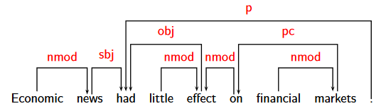
Sentence with dependency parse
Many notational variants (in particular, the arrows often point the opposite way.)
From “Dependency Parsing” Tutorial at COLING-ACL 2006, Joakim Nivre and Sandra Kübler

Slide 45
Constraints on the arrows
Definitely: The arrows form a tree.
More doubtfully: The arrows don’t cross (projective). There are exceptions in English (mostly awkward sounding), and more exceptions in language with looser word order.

Slide 46

Example of a non-projective tree
Note in this example (which I copied off a page on the web): The arrows go down the tree. (from head to dependent). There is an extra “root” node with one child. The arrows are unlabeled. All these are fairly common.

Slide 47
Kinds of relations
Clear-cut cases
subject → verb. John → [subj] bought
object → verb bought → [obj] bread
adjective → noun. white → [nmod] bread
More dubious cases
Subordinate clauses “I think that John bought roses”: bought → that → think (?)
Conjunction: bread and milk. bread ← and ← milk? bread → and ← milk?

Slide 48
Representation of a dependency grammar
As far as I can tell, there is nothing close to a standard approach to characterizing the grammar.
One way is to use a headed grammar: a CFG in which you identify one constituent as being the head. You generate the phrase structure tree as before. Then for each word you travel up head links as far as you can go and put the word there. Then you eliminate nodes not labelled by words.

Slide 49
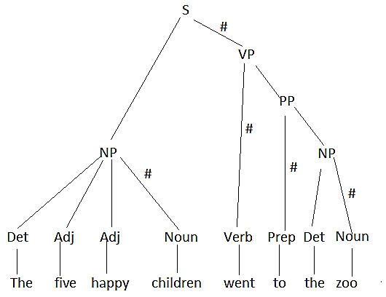
Headed Grammar
S → NP VP# -- # indicates the head
NP → {Det} Adj* Noun# PP
PP → Prep# NP
VP → {Modal} Verb# {NP} PP*

Slide 50
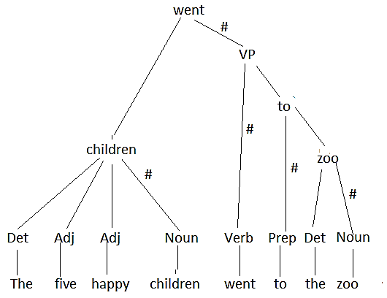
Headed grammar

Slide 51


